Slide 1




CLEARING THE SKIES: AN IN-DEPTH LOOK AT FACTORS BEHIND AIRLINE DELAYS
GROUP - 2
Ankith Gundeboina
Avinash Appineni Pavan Kumar Pula Pavan Sai Teja Kokkura

Slide 2

TABLE OF CONTENTS
1
2
3
INTRODUCTION
DATA OVERVIEW
DATA ANALYSIS
4
5
6
7
MODELING
RESEARCH QUESTIONS
LIMITATIONS
CONCLUSION

Slide 3


INTRODUCTION
IMPACT
IMPORTANCE
FOCUS
Travelers
Airline Company
Airport business
Considering globalization and Industry growth managing a factor like delay is a crucial to enhancing operational performance and lowering economic losses.
Knowing the trends in the delay allows airlines to enhance resource profitability while minimizing traffic.
Analyzing delay factors, including weather, security, and mechanical issues, using a machine learning approach

Slide 4



PROBLEM STATEMENT
Flight delays and cancellations disrupt airline operations, leading to economic losses, reduced productivity, and customer dissatisfaction. These issues stem from various factors, including weather, carrier operations, and systemic inefficiencies. This project aims to leverage machine learning models to accurately predict delays, identify root causes, and classify patterns, providing actionable insights to minimize downtime and improve operational efficiency.

Slide 5
DATA OVERVIEW
The dataset is titled as “Airline_Delay_Cause”
Data is collected by Bureau of Transportation Statistics, USA
Data is airlines traffic based
There are 21 variables and 92k observations in the dataset
The dataset is recorded yearly (2020 - 2024)
The attributes in the dataset are about flight operations and levels of delay
Key variables such as
arr_delay (arrival delay),
carrier_delay,
weather_delay,
nas_delay,
late_aircraft_delay are influenced by factors like the year, month, carrier, airport, and corresponding counts (carrier_ct, weather_ct, etc.)

Slide 6
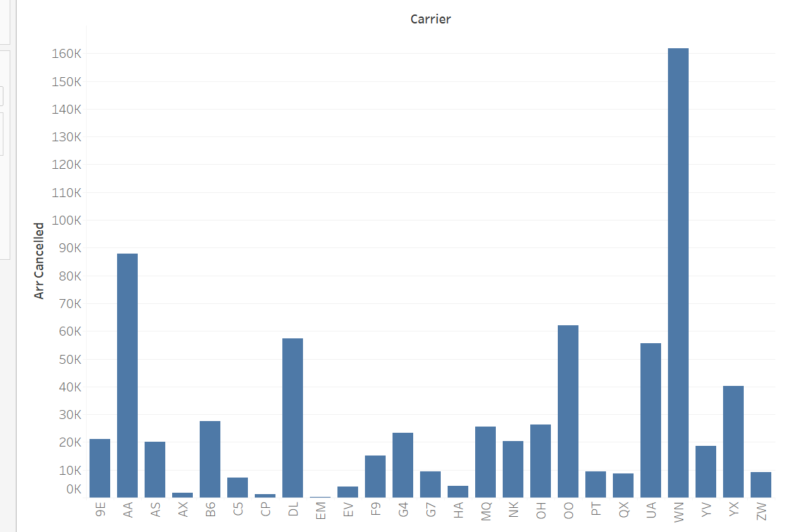
DATA ANALYSIS
TREND OF FLIGHT CANCELLATIONS AMONGST CARRIERS
Shows a cancellation rate per airline.
Bar Chart: Compare the all cancellations for each carrier.
It shows which airlines cancel their flights more than others.
Southwest , American, Delta and Skywest Airlines are experiencing more cancellations

Slide 7
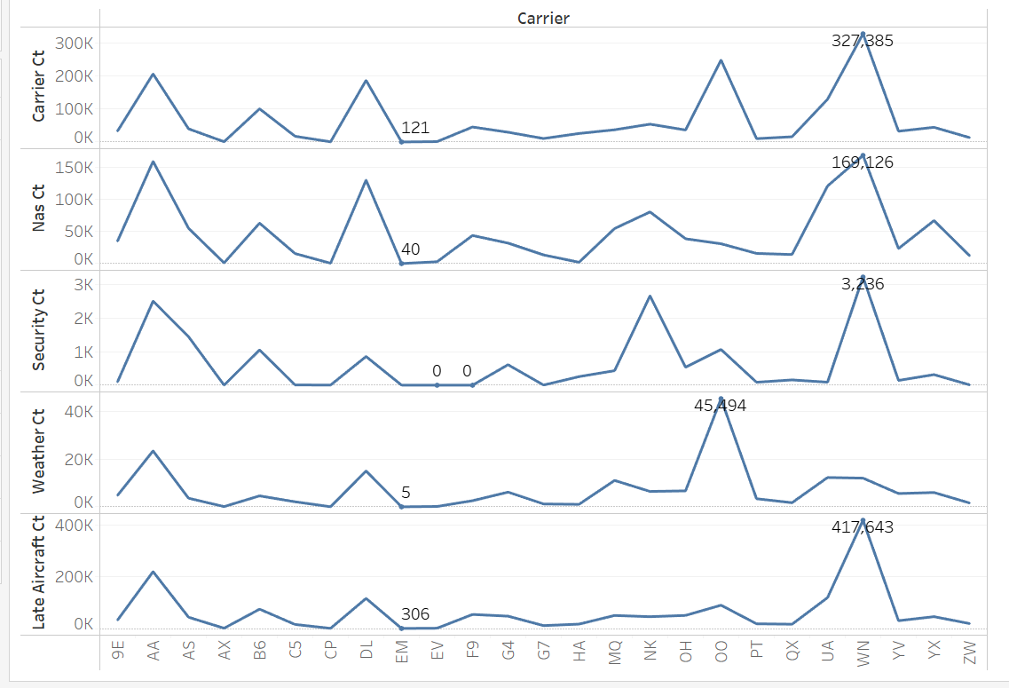
DATA ANALYSIS
Delays influenced by operational factors that contribute to differences in delay performance.
Carrier Delays: High for WN and OO, indicating internal issues like scheduling or staffing.
NAS Delays: Significant for WN, OO, and UA due to congestion at major hubs.
Security Delays: Moderate across carriers with minimal variability.
Weather Delays: Peaks for WN and OO linked to geographically sensitive areas.
Late Aircraft Delays: High for WN, suggesting cascading effects from earlier flights.

Slide 8
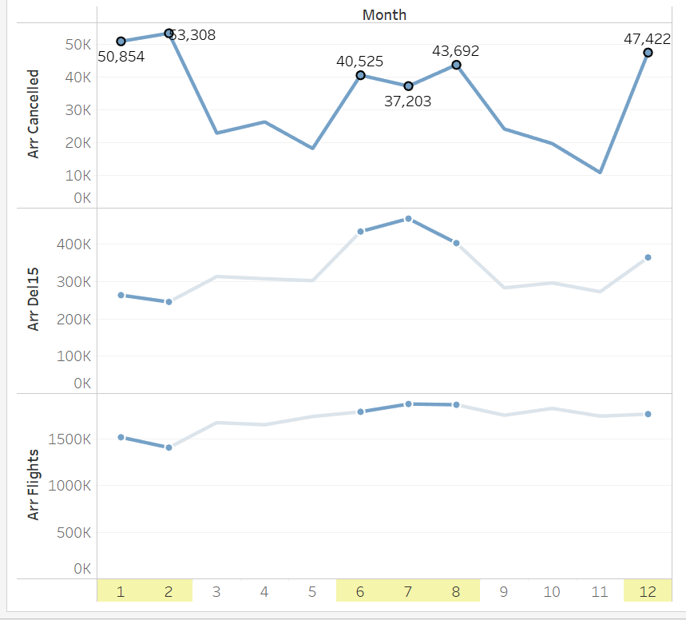
DATA ANALYSIS
A seasonal trend in the number of airline cancellations and delays
This chart illustrates the relationship between arriving flights, aircraft delays, and cancellations across the months of the year.
The data highlights that the highest occurrences of delays and cancellations are observed during December, January, February, as well as June, July, and August.

Slide 9
MODELING
Objective:
Create predictive models needed to categorize and predict different flight delays.
Models Used:
Random Forest: Its features: decision trees with high accuracy and stability against multifactorial delays.
Decision Tree: Easy and clear to identify main causes of delays.
Linear Regression: Determines correlation between delay and its causes.
Evaluation Metrics:
Classification accuracy and cross entropy for classifiers data,
MSE and MAE for regression.

Slide 10

RESEARCH QUESTIONS

Slide 11
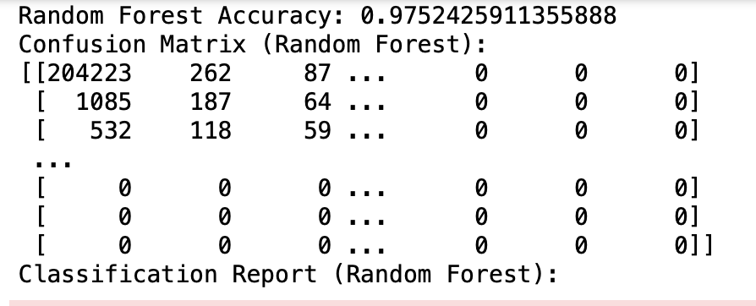

1. Can we predict whether a flight will be canceled based on factors like carrier, weather conditions, NAS issues, and airport location?
Model Used: Random Forest Classifier
Target variable: arr_cancelled (Flight Cancellation)
Included variables:
Time-related: Total Time, Arrival Time Lasted
Frequency-related: Arrival Carrier Frequency, Number of Arriving Flights
Delay counts: carrier_ct, weather_ct, etc.
Data Split:
80% Training, 20% Testing
Model Accuracy: 97.52%
Key Insights:
Carrier-specific delays (carrier_ct) have the highest importance.
Strong correlation between carrier delays and cancellation rates across airlines.

Slide 12
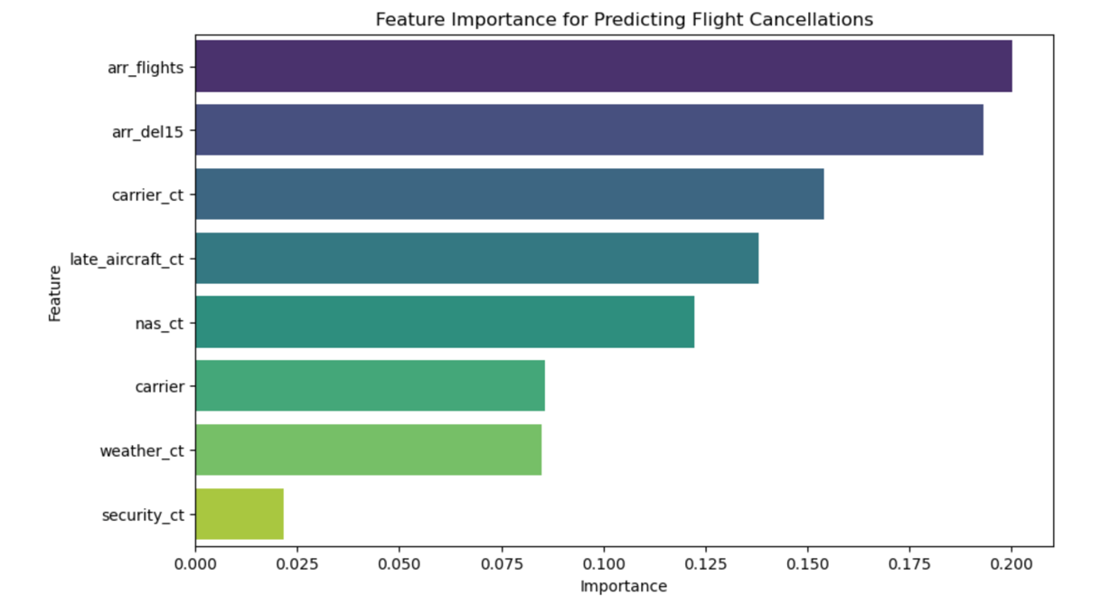
Visualization: Bar Chart
Represents Feature Importance in predicting flight cancellations
Axes:
Y-axis: Features
X-axis: Importance Scores (assigned by Random Forest Classifier)
Purpose: Highlights the contribution of each feature to the model's predictions.

Slide 13
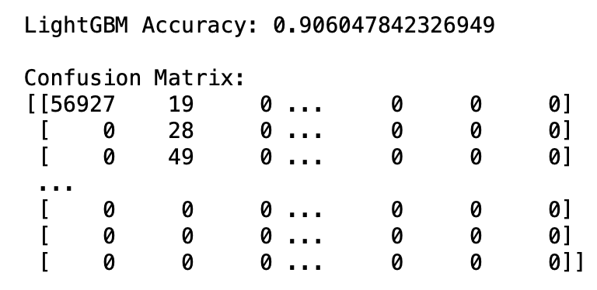
2. Can we predict the likelihood of a flight being delayed by more than 15 minutes using variables like the airline, month, weather conditions, and NAS issues?
Model Used: Gradient Boosting Classifier
Target: Predicting flight delays over 15 minutes
Key Features: Month, carrier, airport, and delay counts
Accuracy: 91% with LightGBM Classifier (100 estimators)
Main Findings:
Month, carrier, and airport are most important for predictions.
Lower recall for delayed flights indicates room for improvement.
Insights: Identified key factors related to operational and seasonal delays.

Slide 14
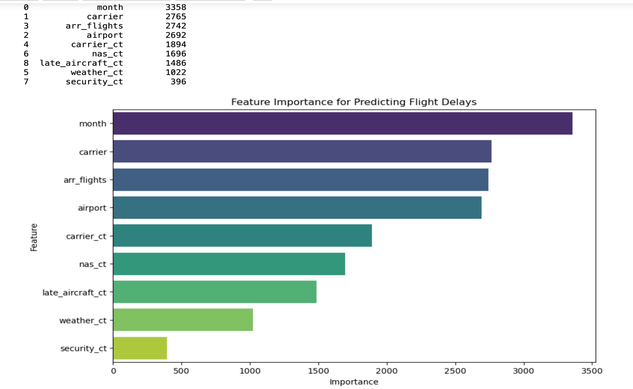
Top Predictors: Month, carrier, number of arriving flights
Impact: Most likely to influence arrival delay
Application: Helps estimate optimal flight connections and minimize delays.

Slide 15
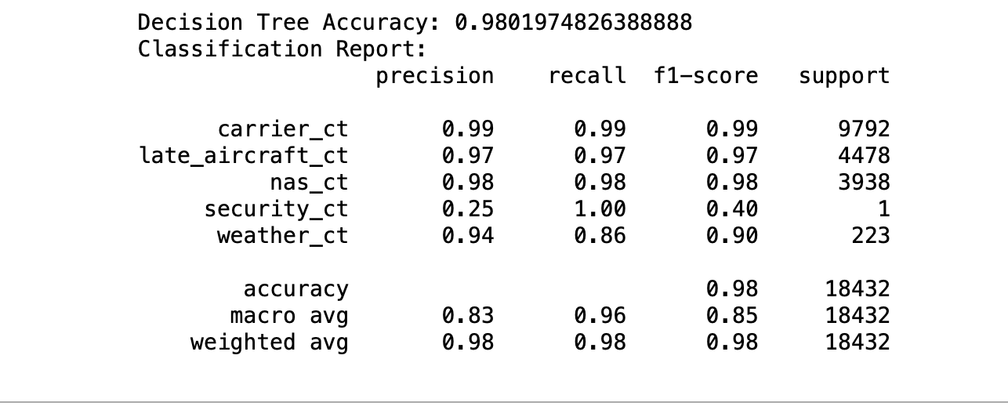
3. Can we classify the root cause of flight delays (carrier, weather, NAS, security, or late aircraft) based on flight data?
Model Used: Decision Tree Classifier
High Performance: Good for carrier, NAS, late aircraft, weather delays
Challenges: Lower precision/recall for weather delay; low performance for security delays (few incidents)
Strengths: High overall accuracy (98.02%); easy to interpret and identify delay causes
Outcome: Successfully predicts flight delay reasons.

Slide 16
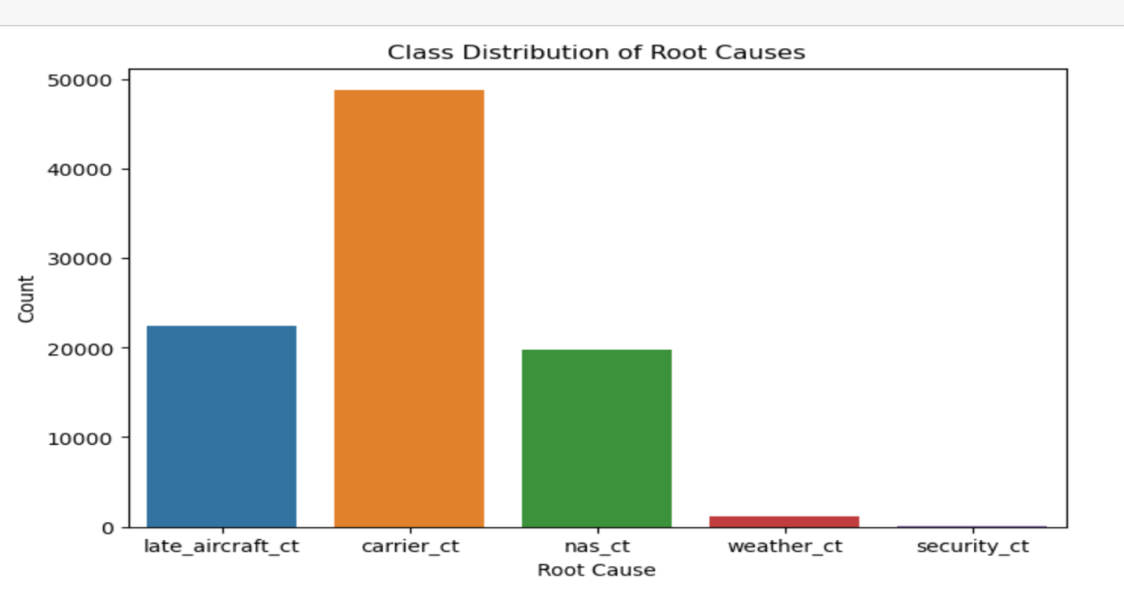
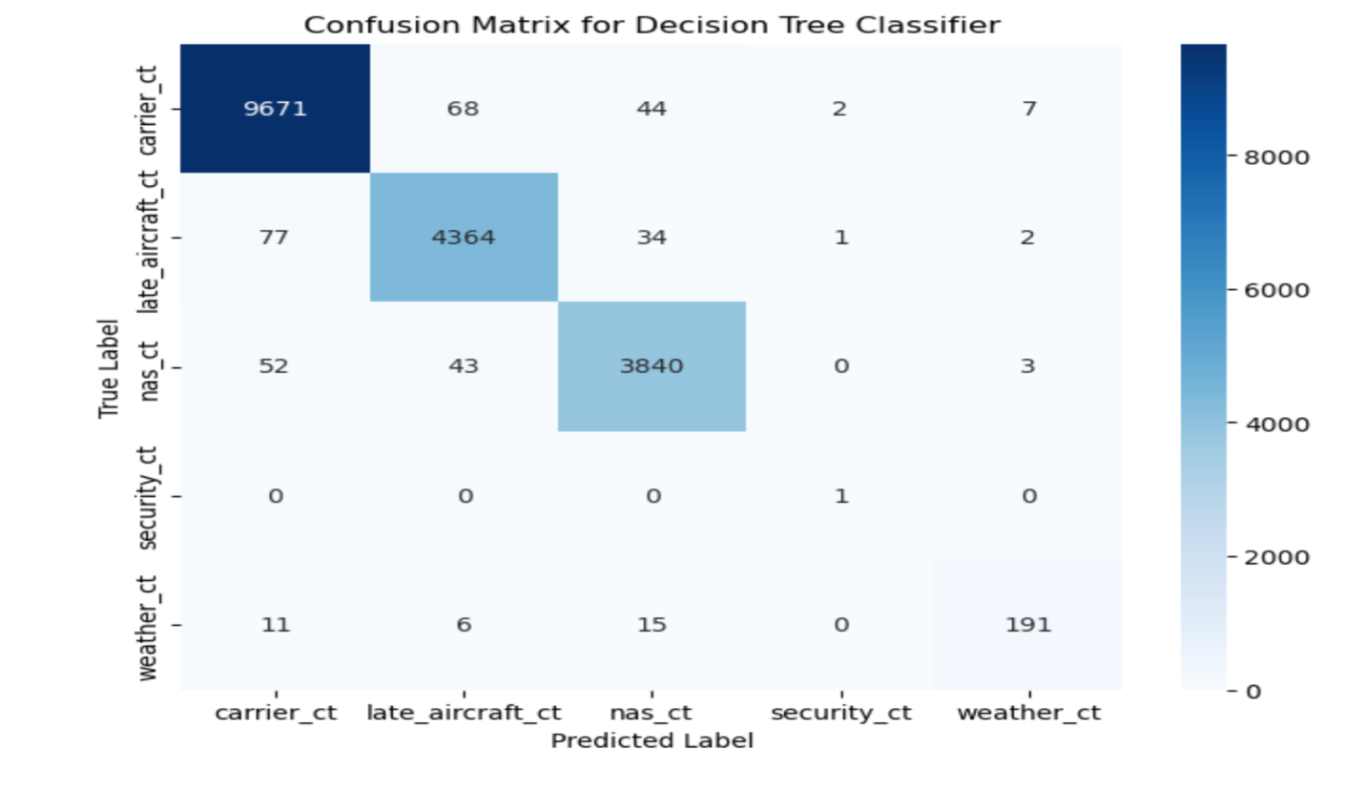
Accuracy: 98.02% for Decision Tree Classifier
High Probabilities: For carrier, NAS, late aircraft delays
Weather Delays: Good performance, slightly lower precision/recall
Model Strength: Effective at assigning probability scores for delay causes
Areas for Improvement: Security class imbalance
Confusion Matrix: Clear overview of model performance by delay type.

Slide 17
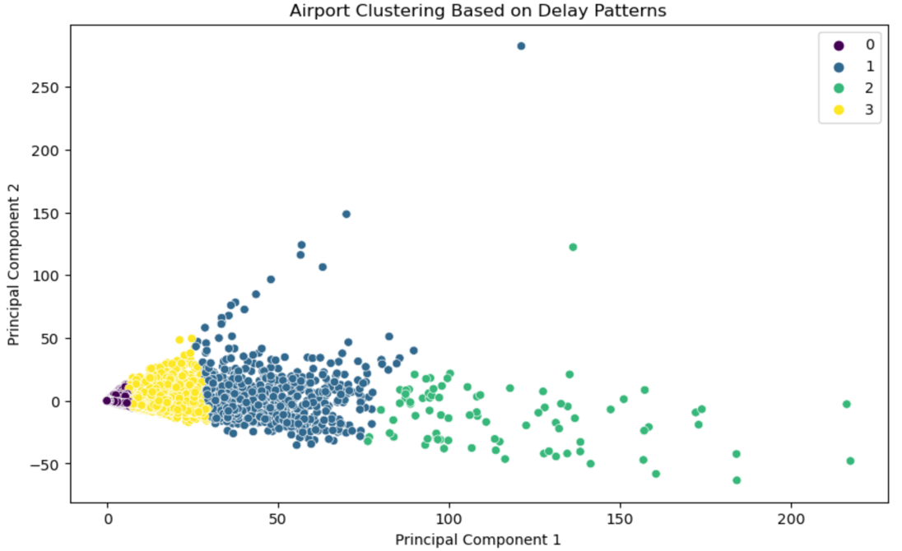
4. Can we cluster airports based on their delay patterns to identify those with the highest likelihood of delays due to specific factors (weather, congestion, etc.)?
Cluster 0: Low delays, small/well-dispersed airports
Cluster 1: Moderate delays, contract-related, NAS, carrier delays, medium-sized airports
Cluster 2: High delays, NAS, carrier, late aircraft delays, busy hub airports
Cluster 3: Small delays, slightly higher carrier_ct, small airports with occasional disturbances
Scatter Plot: 2D visualization using PCA, points color-coded by cluster.

Slide 18
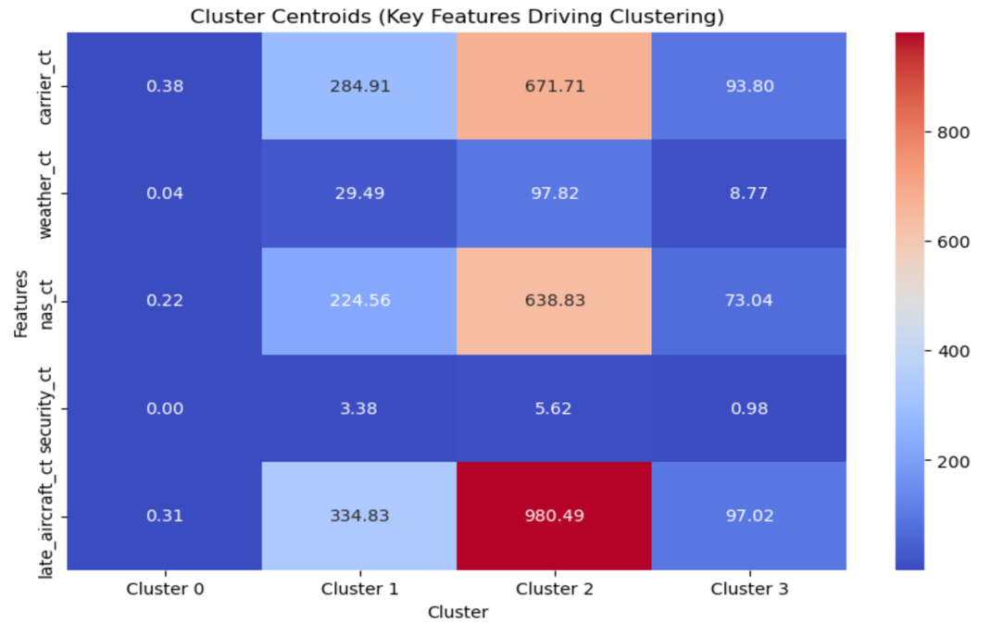
Clustering Insight: Identifies airports with distinct delay patterns
Cluster 2: Represents operational issues
Clusters 0 & 3: Indicate effective management strategies
Visuals: Heatmap shows delays clearly by cluster

Slide 19
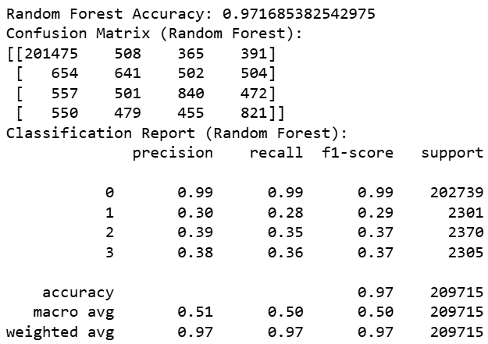
5. Can we predict the peak months for flight cancellations using historical data on cancellations, weather patterns, and flight volumes?
High Accuracy: 97.17% accurate (class 0)
Imbalance Problem: Small classes (1, 2, 3) have low precision and recall

Slide 20
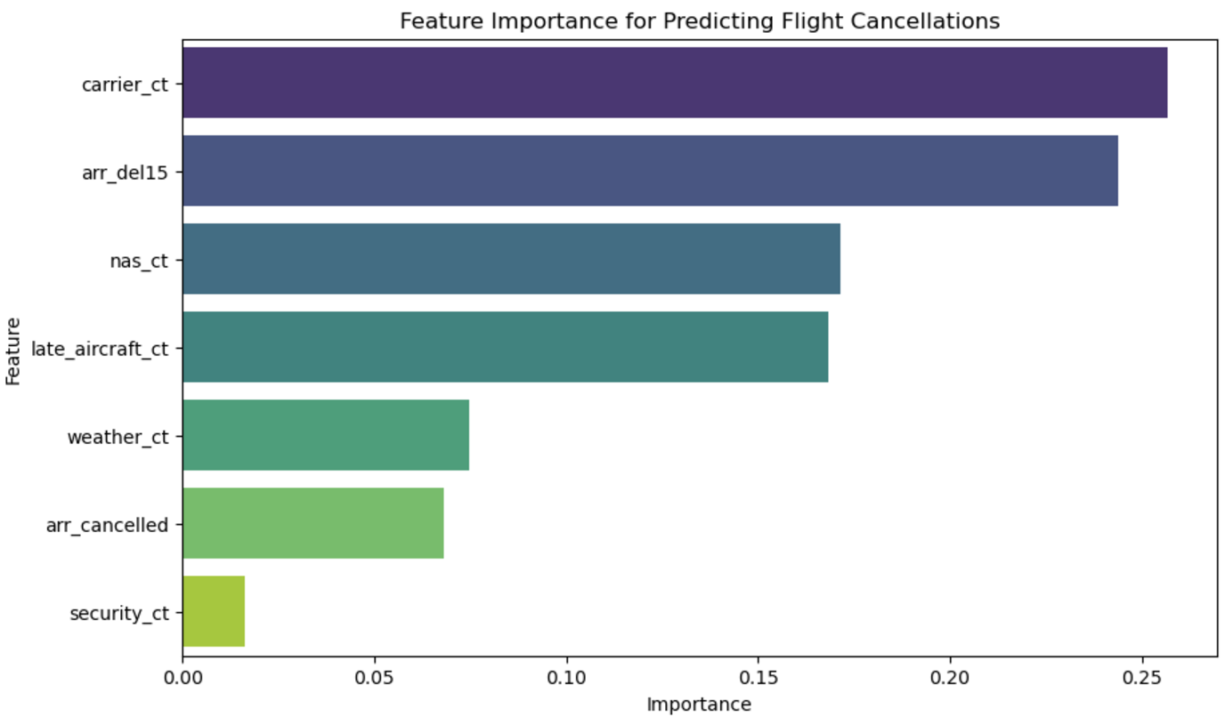
Most Influential Factor: Carrier-related delays (carrier_ct)
Other Key Factors: Arrival delays (arr_del15), National Airspace System issues (nas_ct), late aircraft arrivals (late_aircraft_ct)
Least Influential Factors: Weather-related delays (weather_ct), prior cancellations (arr_cancelled), security delays (security_ct)

Slide 21
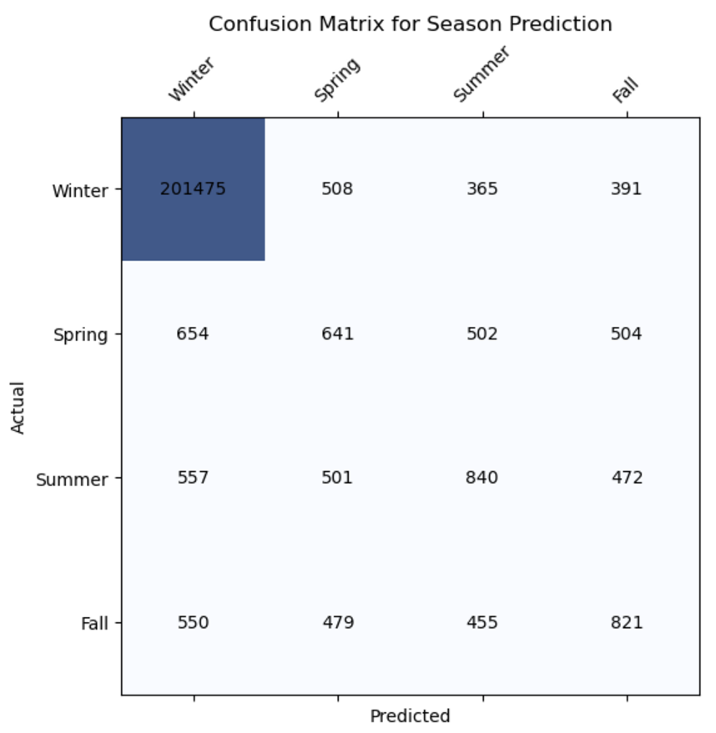
High Accuracy for Winter: 201,475 correct predictions
Misclassifications Exist: Spring often confused with Winter (654 times)
Key Insight: Model performs well in Winter but needs improvement for other seasons

Slide 22
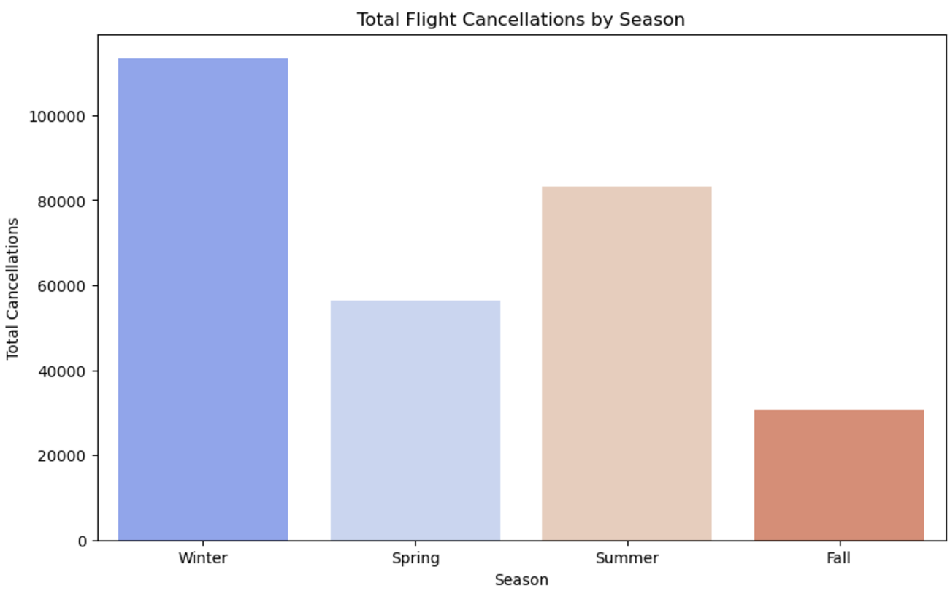
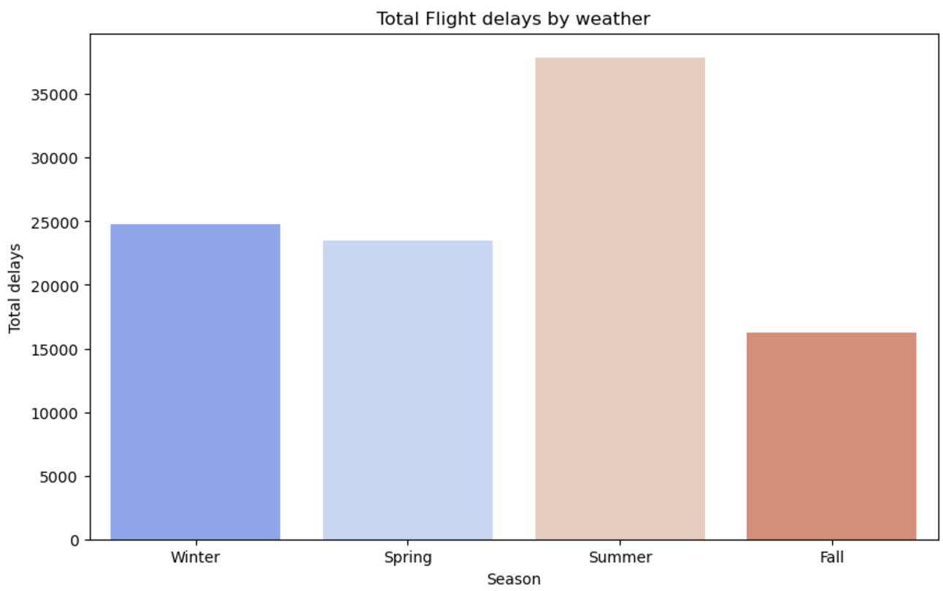
Winter: Highest cancellations (over 100,000)
Summer: Second highest due to storms and demand
Fall: Fewest cancellations, stable weather
Summer: Most delays due to weather, over 35,000
Winter and Spring: Moderate delays, around 25,000 each
Fall: Fewest delays, indicating more stable weather conditions

Slide 23

LIMITATIONS
I
II
CLASS IMBALANCE
FEATURE LIMITATION
Rare delay types (like security delays) are not well-represented, making models biased.
The model's accuracy depends on the chosen features; missing important factors can lower accuracy.
III
MODEL COMPLEXITY
IV
CLUSTER UNDERSTANDING
Gradient Boosting needs careful tuning and may overfit, affecting performance on complex data.
It can be hard to make sense of clusters without specific knowledge about the industry.

Slide 24

















CONCLUSION
In conclusion, this project analyzed airline delays and cancellations to uncover key trends and causes. Predictive models helped forecast delays, estimate durations, identify cascading delays, and cluster airports by delay patterns, offering valuable insights for passengers, airlines, and airports.
While the models performed well, challenges like class imbalance and limited features remain. Future efforts can focus on tailored models for specific airlines or regions to enhance accuracy and efficiency in flight operations.

Slide 25
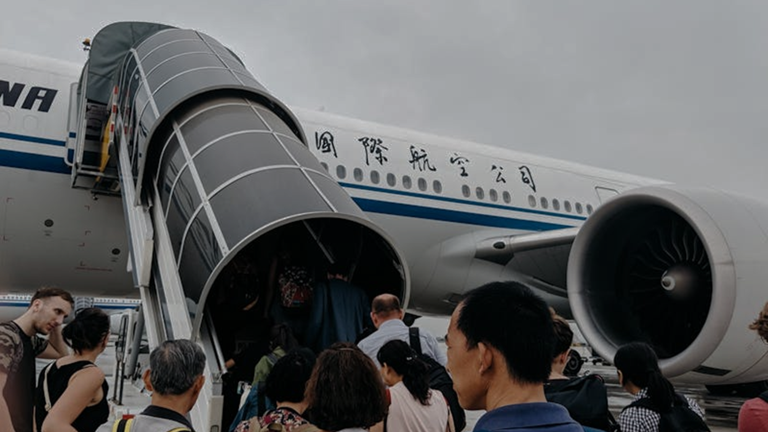
THANK YOU!

